Slide 1
Management skills

Slide 2
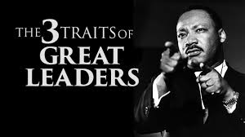

Three Key Factors of Great Companies
1 Mission Statements
2 Great Managers
3 Great Employees

Slide 3


3 Basic Management Skills
Management: Management includes the activities of setting the strategy of an organization and coordinating the efforts of its employees (or of volunteers) to accomplish its objectives
Anyone can be a manager. There is no perfect receipt to be good at it. However, you must work at achieving three basic skills:

Slide 4


Three Basic Skills of Management:
Strong Leadership
Strong Interpersonal Skills
Strong Communication Skills

Slide 5

What is Leadership
What does this tell leadership is?
Hopefully, you found that there are many different definitions:
Stogdill (1974, pp.7-16) reported and classified over 70 definitions of leadership,
Bennis (1982) refers to over 350 different definitions of leadership and
Bass (1990, p.11-18) to several hundred definitions of leadership.

Slide 6
Three Basic Skills of Management:
Leadership - the ability to direct a group of people or an organization in realizing a common goal by creating commitment and enthusiasm amongst followers to achieve goals
Interpersonal Skills - The abilities we use to work cooperatively with other people are called interpersonal skills
Communication Skills - are the ability to share ideas and feelings effectively. They include verbal, nonverbal, written, and visual skills

Slide 7
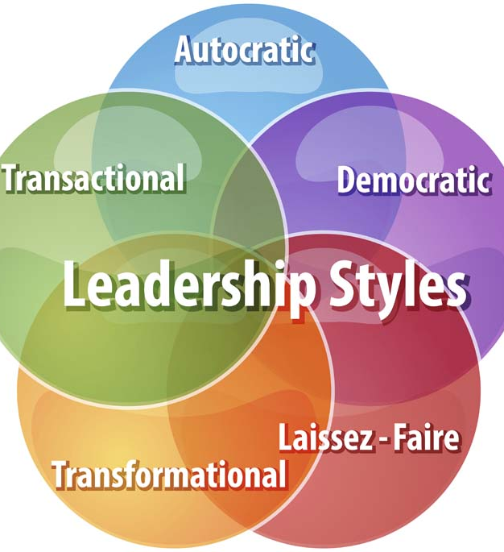
Assignment
Go to Google Classroom and watch the video How to be a Leader: The Seven Traits of a Strong Leader.
Answer the questions and complete your note packet on page 4.

